Slide 1
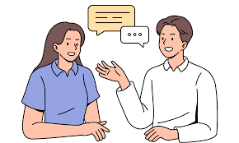


Speaking Skills
4/8/2025

Slide 2
Agenda
9.1. What is speaking?
Strategies for Speaking Skills Development
9.2. Speaking in different ways
Adapting your style
Formal and informal language
Exercises

Slide 3
9.1. What is speaking?
-makes a human different and better than
the other types of living creatures
complex, subjective, and linguistic ability
A child figures out how to talk through interacting with the individuals around him/her in their local language.

Slide 4
-grown-up can talk in our local language without effort and
this expertise is a characteristic one
However
speaking in an unknown language isn’t regular and it requires conscious struggle through the entire procedure.
Speaking is a verbal ability that includes words and sounds. It likewise includes:
Meaning: implication, signification, grammar
Sociality, Relationship, Affect: formal, casual, slang, turn-taking
Social Issues: class, ethnicity, nationality, religion, sex, vernacular
Execution/Implication: pronunciation, projection, speech

Slide 5
Sound Elements: how volume, pitch, pace, and nature of sound supplement
Speaking
a creative aptitude that includes listening ability.
"Without tuning in, talking is unimaginable and the connection between these two abilities is relating," means that true conversation isn't just about speaking, but about connecting with another person.
"Tuning in" means actively listening and paying attention to the other person. It's about trying to understand their feelings, their perspective, and what they're trying to communicate, both with their words and their body language.
Notes:
"Tuning in" means actively listening and paying attention to the other person. It's about trying to understand their feelings, their perspective, and what they're trying to communicate, both with their words and their body language.

Slide 6
Great speakers and linguists state that
They encourage the fact of having an ability to quickly analyze and understand the conversation and then share your thoughts with others.
you should always think before you speak

Slide 7
9.1.1 Strategies for Speaking Skills Development
capacity to communicate in a language is the result of speaking Skill Development
However, talking is additionally a vital piece of the language learning process.
Speaking English confidently is an important goal for many institutions.
we hesitate because we are afraid of making mistakes or embarrassing ourselves in front of others.

Slide 8
-mistakes are unavoidable.
You can improve your spoken English if you practice regularly and follow these simple techniques.
1. Listen:.
2. Imitate:
3. Read:
4. Reflect:
5. Prepare:
6. Speak:
7. Practice:
Notes:
1. Listen: The first step in improving your speaking skills is actually working on your listening.
2. Imitate: Now that you have listened to lots of English conversations, it’s time for some imitation. Imitating or copying someone is a wonderful to improve your speaking skills. Another benefit of imitation is that it will help you become more accurate in English without having to learn grammar rules.
3. Read: Reading is yet another important skill to have when learning a language. Reading a few minutes every day will help you acquire new vocabulary.
4. Reflect: Reflection is a very useful step in improving your speaking skills. Reflection is nothing but asking questions to think about what you learnt, how you learnt, what progress you see, what could be done differently, and how to change the way you learn to allow progress.
5. Prepare: A lot of us hesitate to speak or take part in conversations in English because we are nervous about what to say. We are anxious that what we say may not be appropriate or we may make mistakes. We can easily fix this problem by preparing ahead.
6. Speak: There is no magic pill that would help you speak better. You must put yourself in situations where you are forced to speak in English to get better at
7. Practice: We cannot stress this enough. Regular and consistent practice is the key to success when it comes to speaking English.it. Start small.

Slide 9


don’t forget to have fun
It’s easier to learn something new and commit to learning when you’re having fun. Practice English by singing along to popular songs.

Slide 10
9.2 Speaking in different ways
Speaking and listening skills are important in all aspects of your life
you get by in everyday situations, connect with other people, and build and maintain relationships.
People are influenced by what you say and you need to make sure that you are easily understood by others

Slide 11
Everyday speaking and listening
applies to your working life as well as your personal life
able to listen and to speak clearly and confidently are skills that are highly valued whatever your job
important to use the correct language for the context
should adapt your style and approach to suit your audience.

Slide 12
For example,
the way you would describe your symptoms to the doctor is different from describing the same illness to a friend
if you were collecting money for a good cause, you would persuade your friends to contribute using different language from what you would use with a stranger.
The language and style you use when you are speaking will depend on:
who you are talking to
the situation
what you expect or hope to happen as a result.

Slide 13
9.2.1 Adapting your style
You can adapt your language to the listener and the situation by keeping these questions in mind as you plan what you are going to say:
Who …?
Why …?
What …?
How …?
For example:
Who am I speaking to?
Why am I giving this explanation?
What do I want to achieve?
How can I achieve that?

Slide 14
you speak in different ways depending on the people and the situation. The main difference, which helps to decide on your form of language, is whether the situation is formal or informal.
Formality usually depends on who you are speaking to and in what context. For example, you may use more formal English to speak to your boss and less formal slang to speak to your friends.

Slide 15
9.2.2 Formal and informal language
Formal and informal language styles differ in
tone,
vocabulary, and
sentence structure,
impacting how messages are received in different contexts

Slide 16
Formal language is used in professional, academic, and official settings, employing proper grammar, specific vocabulary, and avoiding contractions and slang.
Informal language, used with friends and family, is more casual, spontaneous, and may include contractions, colloquialisms, and simpler sentence structures.

Slide 17
Formal language is a style of speech used when you are speaking to someone you don’t know or on whom you want to make a good impression.
Informal language is a style of speech where choice of words and grammar tends to be familiar rather than formal. It is used when you know, or want to get to know, the person you are speaking to.
Slang is very informal language that is usually spoken rather than written. It is commonly used among friends when speaking or sending text messages.

Slide 18
Formal language is more likely to be grammatically correct.
For example, you would say ‘I have not’
rather than
the grammatically incorrect ‘I aren’t’.

Slide 19
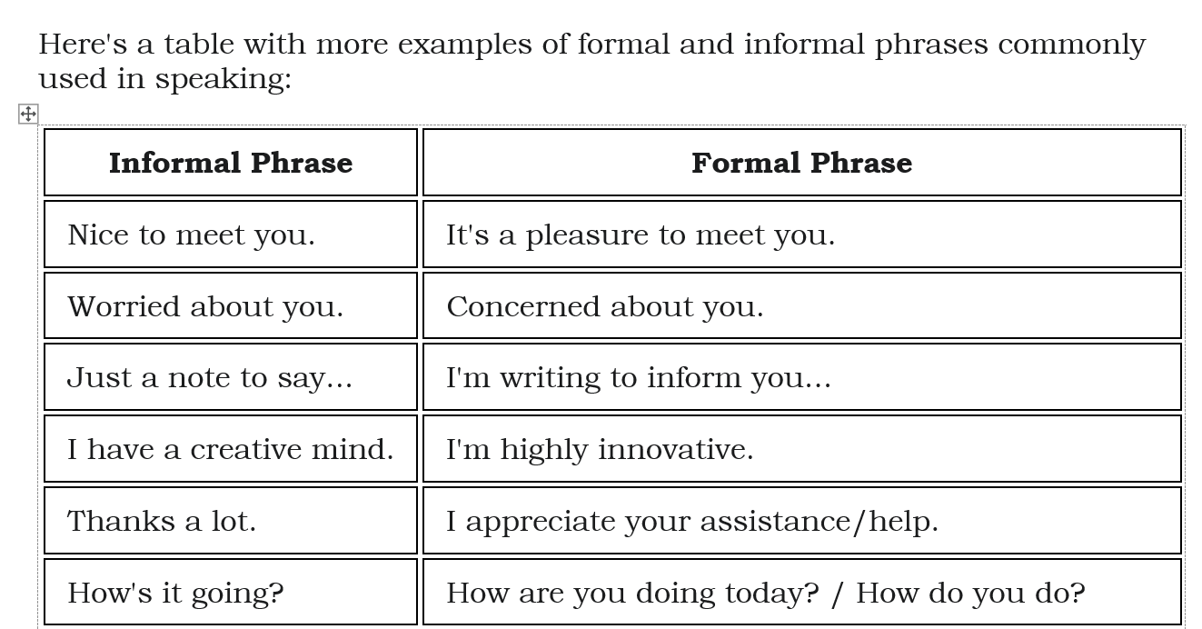

Slide 20
Go to the pdf file page 14 and 15 study some of the formal and informal phrases

Slide 21
Do the exercises on page 15, 16 and 17

Slide 22
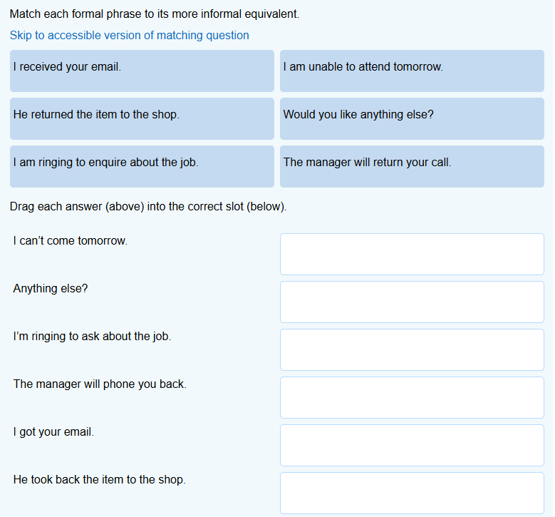
I am unable to attend tomorrow.
Would you like anything else.
I am ringing to enquire about the job.
The manager will return your call.
I received your email.
He returned the item to the shop.

Slide 23
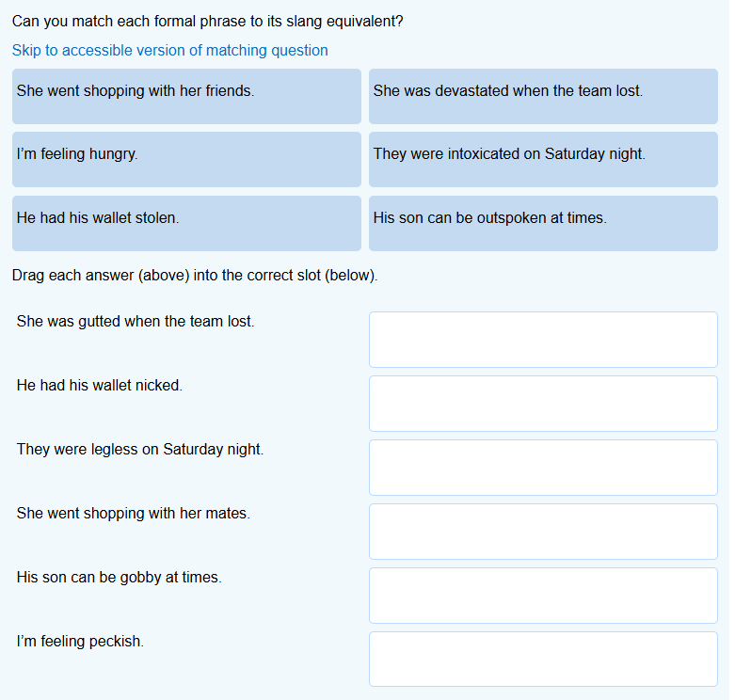
She was devastated when the team lost.
He had his wallet stolen.
They were intoxicated on Saturday night.
She went shopping with her friends.
His son can be outspoken at times.
I’m hungry.

Slide 24
1. "The quarterly earnings report indicates a substantial increase in profitability."
Register: Primarily Formal.
Reasoning: This sentence uses precise, professional vocabulary typical of business or academic writing. Words like "quarterly earnings report," "indicates," "substantial," and "profitability" are formal and rarely used in casual conversation. The sentence structure is also direct and factual.
2. "What's up? Want to grab some coffee later?"
Register: Primarily Informal.
Reasoning: This is a classic example of casual, conversational language. "What's up?" is a common informal greeting. The phrase "grab some coffee" is an idiomatic and relaxed way of suggesting a meeting, rather than a more formal alternative like "Would you like to meet for coffee?"

Slide 25
3. "This endeavor presents a unique opportunity for collaborative growth."
Register: Primarily Formal.
Reasoning: The language is elevated and strategic. The word "endeavor" is a more formal synonym for "project" or "effort." "Presents a unique opportunity" and "collaborative growth" are phrases commonly found in business proposals, mission statements, or formal presentations.
4. "I'm totally swamped with work right now, so I can't make it."
Register: Primarily Informal.
Reasoning: The sentence uses informal and conversational expressions. "Totally swamped" is a colloquialism for being very busy. "Can't make it" is a casual way of saying "I am unable to attend." The contraction "I'm" also points to an informal tone.

Slide 26
5. "Participants are advised to familiarize themselves with the safety protocols."
Register: Primarily Formal.
Reasoning: This sentence uses formal, instructional language. "Participants are advised" is a direct, official instruction. The words "familiarize themselves" (instead of "read" or "look at") and "safety protocols" (instead of "safety rules") are specific, technical terms used in official communications, like a company memo or a public announcement.

Slide 27

Thank you

